Slide 1
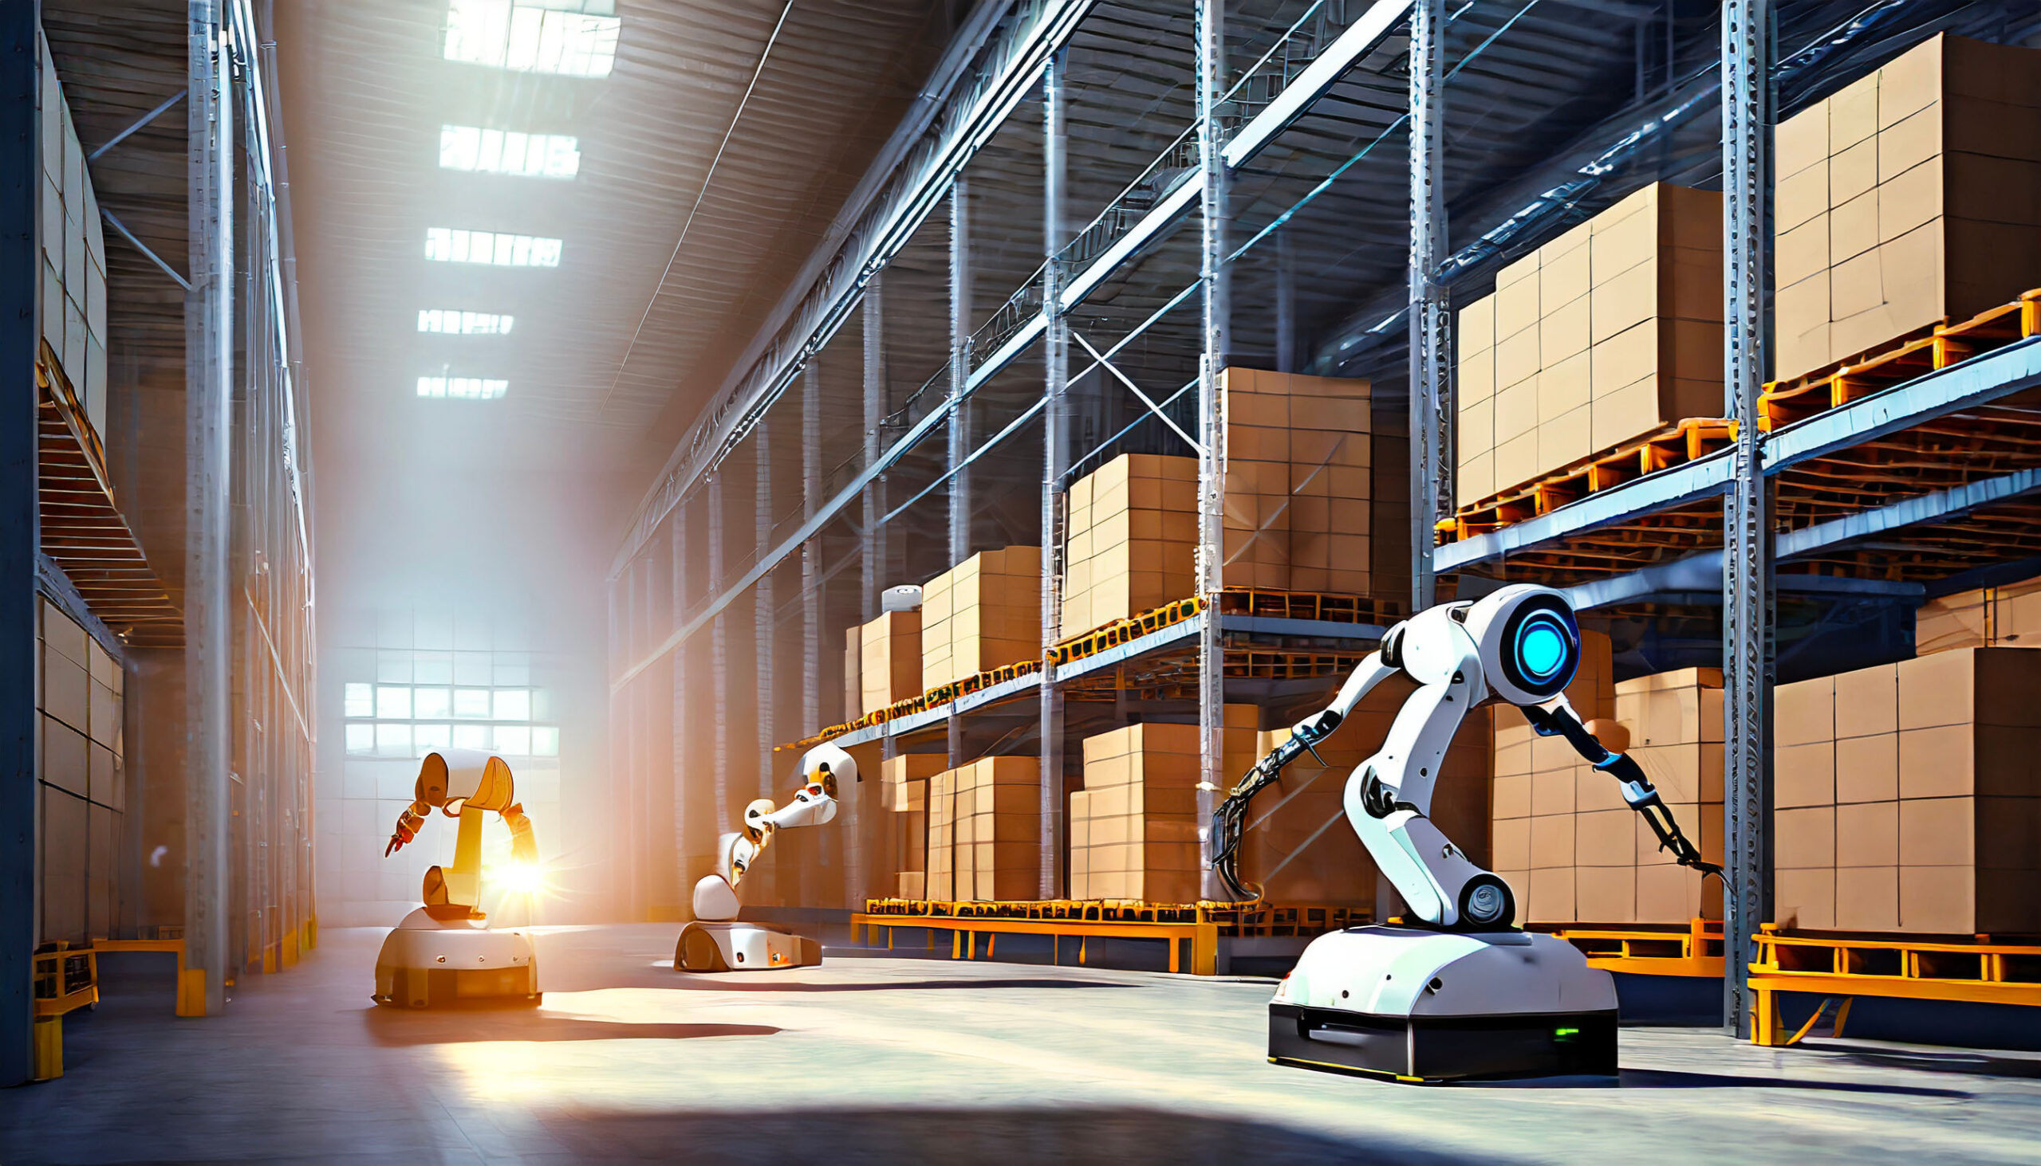
Warehouse Robotics . Priority Deliveries and Deadlines
Artificial Intelligence 2
PDDL & PDDL+
Andrea Laura

Slide 2
Scenario . A warehouse logistics scenario where autonomous robots deliver packages while managing priorities and deadlines through intelligent scheduling.
Problem Statement
Autonomous robots deliver packages
Some packages are urgent
Deliveries have deadlines
Multiple robots operate simultaneously
Need efficient scheduling
Goal
Deliver all packages respecting:
Priorities
Deadlines
Cost minimization

Slide 3
Basic pddl model
Domain
problems
Domain Characteristics: robots, tasks, constraints
Predicates: at, package-at, free, delivered, destination, connected, priority levels (high, medium, low), must-before
Functions: total-cost
Actions: move, pick up, deliver
Problem with NO urgency or deadlines
Problem with priority packages

Slide 4
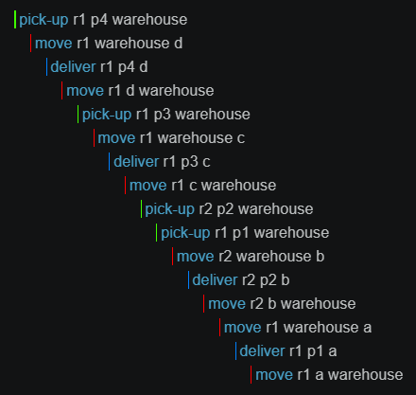
PROblem with no urgency
Baseline scenario:
2 robots
4 packages
4 customer locations
No priority constraints are included and no must-before predicates.
The planner is free to choose any delivery order minimizing the total cost.
Robots return to the warehouse

Slide 5
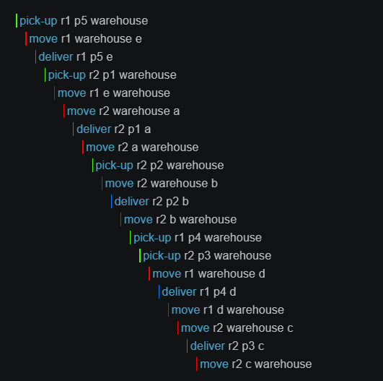
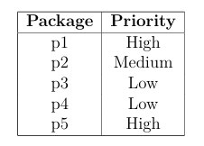
Problem with package priorities
Package are classified as :
Ordering constraints: must-before
This forces high-priority packages to be delivered before medium-priority packages and before low-priority ones.

Slide 6
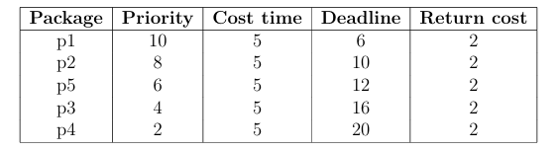
Pddl+ model
domain
problem
Introducing a process modelling time progression called time-passing.
Numerical representation of package priorities and deadlines.
Delivery and return activities are executed through a continuos process
A deadline-violation event makes the plan unsolvable when a package exceeds its deadline
2 Robots (r1, r2)
5 Packages and 5 customer locations
Delivery and return durations
Deadlines
Priority values for each package
The goal requires: all packages to be delivered and no deadline violation.

Slide 7
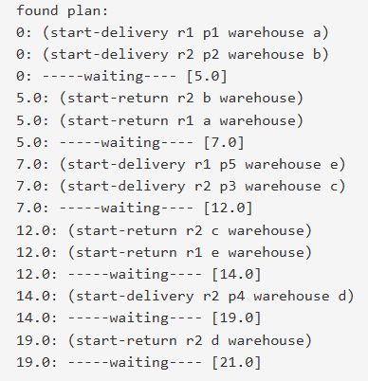
Plan pddl+
The ENHSP Planner successfully generated a feasible temporal schedule that satisfies all delivery deadlines while efficiently coordinating concurrent robot operations.

Slide 8
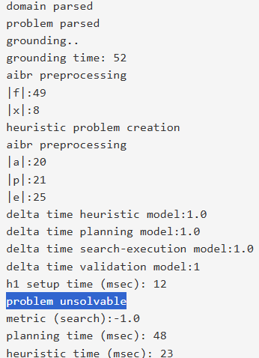
Plan unsolvable
If a package exceeds its deadline, a deadline-violation event is triggered. Since the goal requires all packages to be delivered on time, the planner correctly reports the problem as unsolvable

Slide 9
conclusion
Classical PDDL models package urgency through precedence constraints and generates valid delivery sequences.
PDDL+ extends the model with explicit temporal reasoning, delivery durations, and deadline management.
Temporal planning allows the planner to evaluate schedule feasibility and detect deadline violations.
The proposed models can be easily extended to larger and more realistic warehouse logistics scenarios.

Slide 10
Thank you!!!

